Slide 1

CSC334 - Parallel & Distributed Computing
Chapter 1: Introduction
Mr. Aoun Haider, Ms. Muntaha Amjad

Slide 2
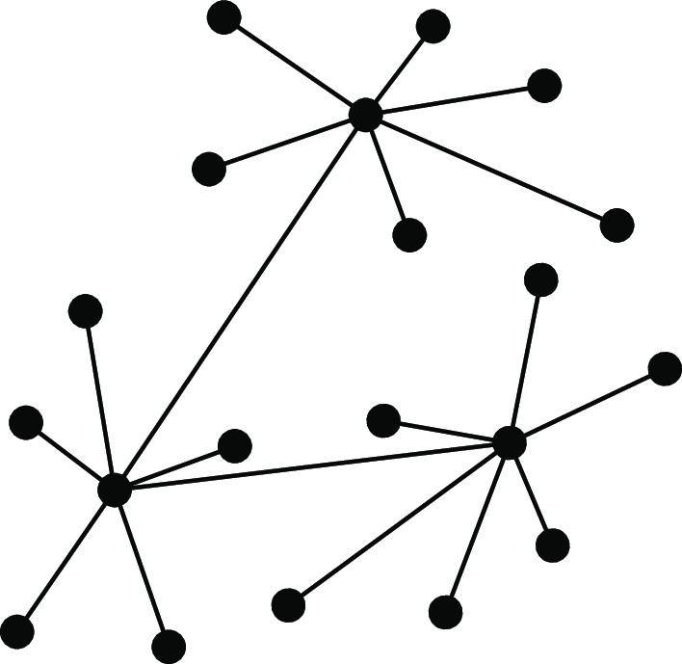
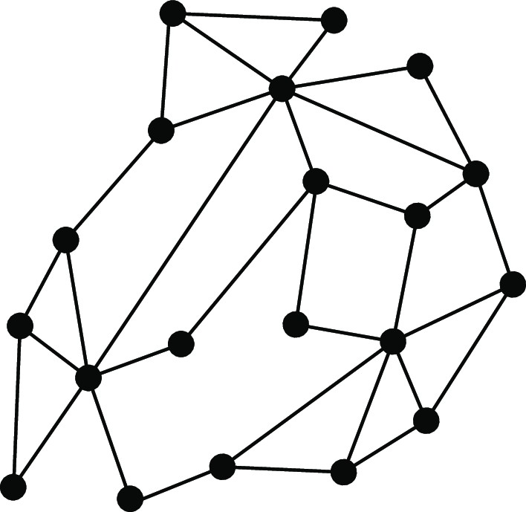
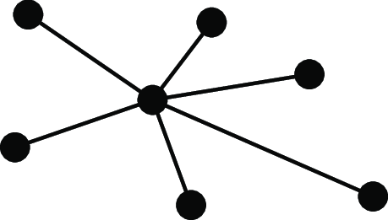
Introduction
CSC334 – Parallel & Distributed Computing
Distributed versus Decentralized
What many people state
Centralized
Decentralized
Distributed
Distributed versus decentralized systems

Slide 3
Introduction
CSC334 – Parallel & Distributed Computing
Distributed versus Decentralized
What many people state
Centralized Decentralized Distributed
When does a decentralized system become distributed?
Distributed versus decentralized systems

Slide 4
Introduction
CSC334 – Parallel & Distributed Computing
Distributed versus Decentralized
What many people state
Centralized Decentralized Distributed
When does a decentralized system become distributed?
Adding 1 link between two nodes in a decentralized system?
Distributed versus decentralized systems

Slide 5
Introduction
CSC334 – Parallel & Distributed Computing
Distributed versus Decentralized
What many people state
Centralized Decentralized Distributed
When does a decentralized system become distributed?
Adding 1 link between two nodes in a decentralized system?
Adding 2 links between two other nodes?
Distributed versus decentralized systems

Slide 6
Introduction
CSC334 – Parallel & Distributed Computing
Distributed versus Decentralized
What many people state
Centralized Decentralized Distributed
When does a decentralized system become distributed?
Adding 1 link between two nodes in a decentralized system?
Adding 2 links between two other nodes?
In general: adding k > 0 links....?
Distributed versus decentralized systems

Slide 7
Alternative approach
Introduction CSC334 – Parallel & Distributed Computing
Two views on realizing distributed systems
Integrative view: connecting existing networked computer systems into a larger a system.
Expansive view: an existing networked computer systems is extended with additional computers
Distributed versus decentralized systems

Slide 8
Alternative approach
Introduction CSC334 – Parallel & Distributed Computing
Two views on realizing distributed systems
Integrative view: connecting existing networked computer systems into a larger a system.
Expansive view: an existing networked computer systems is extended with additional computers
Two definitions
A decentralized system is a networked computer system in which processes and resources are necessarily spread across multiple computers.
A distributed system is a networked computer system in which processes and resources are sufficiently spread across multiple computers.
Distributed versus decentralized systems

Slide 9
Some common misconceptions
Introduction CSC334 – Parallel & Distributed Computing
Centralized solutions do not scale
Make distinction between logically and physically centralized. The root of the Domain Name System:
logically centralized
physically (massively) distributed
decentralized across several organizations
Distributed versus decentralized systems

Slide 10
Some common misconceptions
Introduction CSC334 – Parallel & Distributed Computing
Centralized solutions do not scale
Make distinction between logically and physically centralized. The root of the Domain Name System:
logically centralized
physically (massively) distributed
decentralized across several organizations
Centralized solutions have a single point of failure
Generally not true (e.g., the root of DNS). A single point of failure is often:
easier to manage
easier to make more robust
Distributed versus decentralized systems

Slide 11
Some common misconceptions
Introduction CSC334 – Parallel & Distributed Computing
Centralized solutions do not scale
Make distinction between logically and physically centralized. The root of the Domain Name System:
logically centralized
physically (massively) distributed
decentralized across several organizations
Centralized solutions have a single point of failure
Generally not true (e.g., the root of DNS). A single point of failure is often:
easier to manage
easier to make more robust
Important
There are many, poorly founded, misconceptions regarding scalability, fault tolerance, security, etc. We need to develop skills by which distributed systems can be readily understood so as to judge such misconceptions.
Distributed versus decentralized systems

Slide 12
Perspectives on distributed systems
Introduction CSC334 – Parallel & Distributed Computing
Distributed systems are complex: take persepctives
Architecture: common organizations
Process: what kind of processes, and their relationships
Communication: facilities for exchanging data
Coordination: application-independent algorithms
Naming: how do you identify resources?
Consistency and replication: performance requires of data, which need to be the same
Fault tolerance: keep running in the presence of partial failures
Security: ensure authorized access to resources
Studying distributed systems

Slide 13
Introduction
CSC334 – Parallel & Distributed Computing
What do we want to achieve?
Overall design goals
Support sharing of resources
Distribution transparency
Openness
Scalability

Slide 14
Introduction
CSC334 – Parallel & Distributed Computing
Sharing resources
Canonical examples
Cloud-based shared storage and files
Peer-to-peer assisted multimedia streaming
Shared mail services (think of outsourced mail systems)
Shared Web hosting (think of content distribution networks)
Observation
“The network is the computer”
(quote from John Gage, then at Sun Microsystems)
Resource sharing

Slide 15
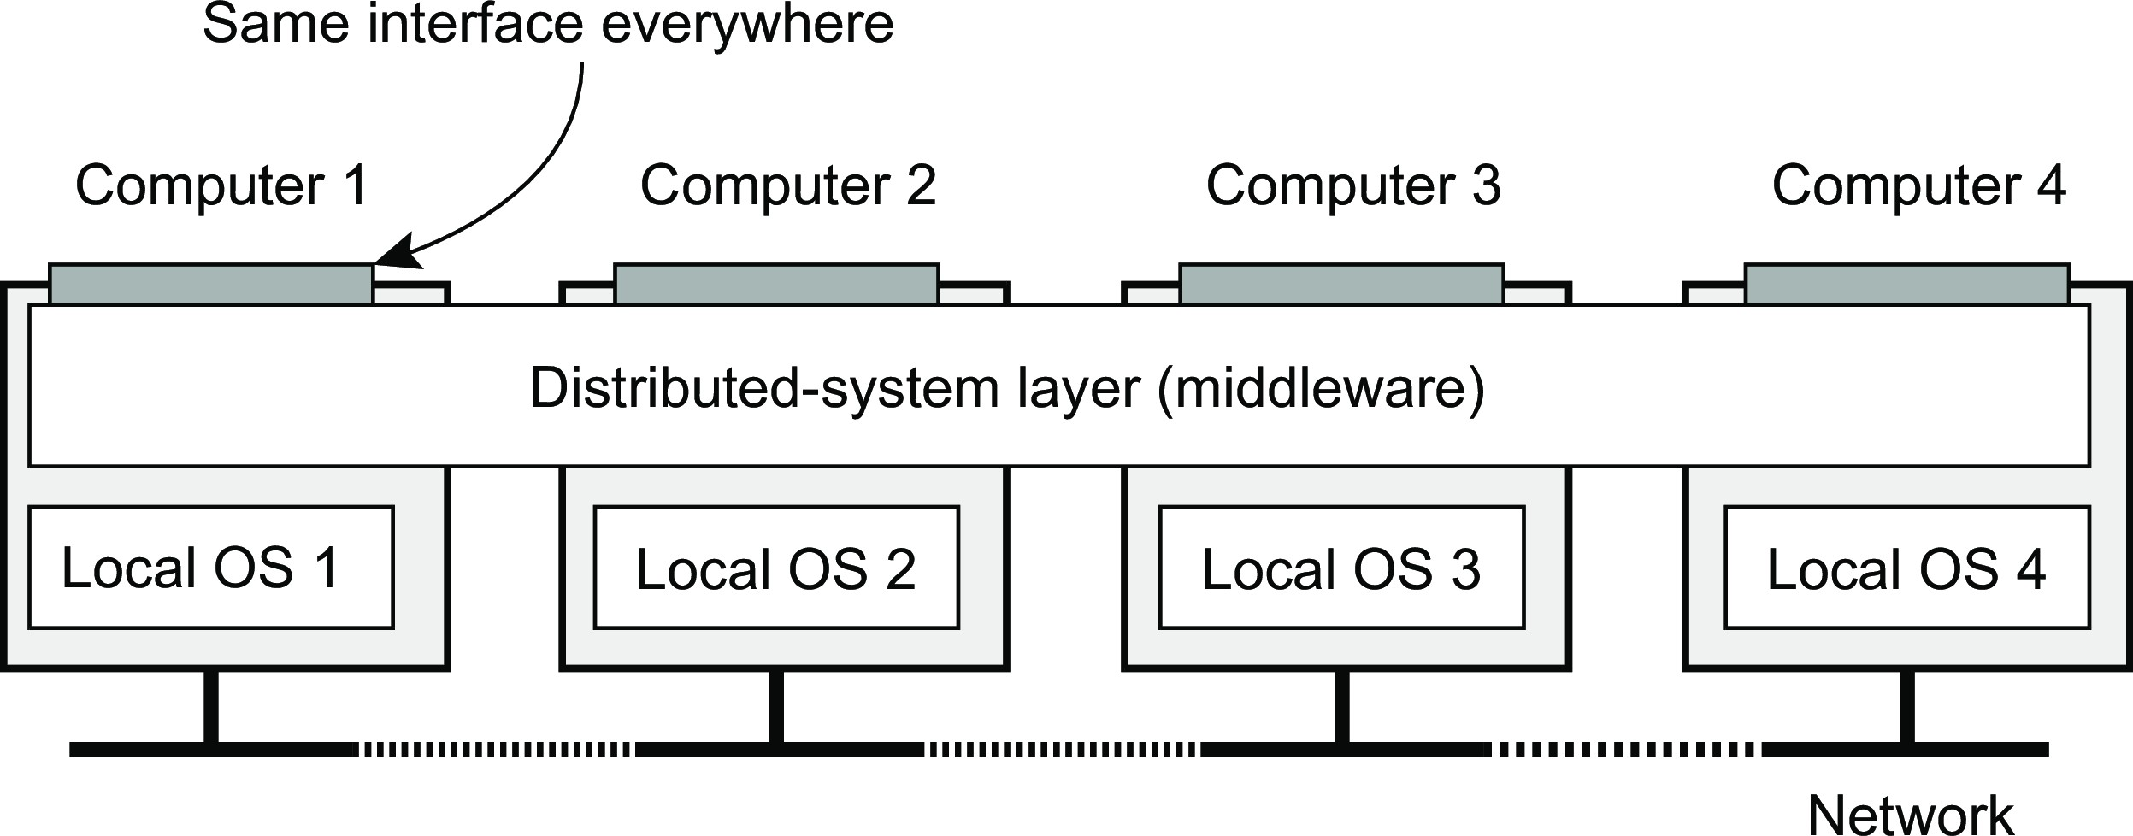
Introduction
Design goals
Distribution transparency
What is transparency?
The phenomenon by which a distributed system attempts to hide the fact that its processes and resources are physically distributed across multiple computers, possibly separated by large distances.
Distribution transparency

Slide 16
Introduction
Design goals
Distribution transparency
What is transparency?
The phenomenon by which a distributed system attempts to hide the fact that its processes and resources are physically distributed across multiple computers, possibly separated by large distances.
Observation
Distribution transparancy is handled through many different techniques in a layer between applications and operating systems: a middleware layer
Distribution transparency

Slide 17
Introduction
Design goals
Distribution transparency
Types
Transparency | Description
Access | Hide differences in data representation and how an object is accessed
Location | Hide where an object is located
Relocation | Hide that an object may be moved to another location while in use
Migration | Hide that an object may move to another location
Replication | Hide that an object is replicated
Concurrency | Hide that an object may be shared by several independent users
Failure | Hide the failure and recovery of an object
Distribution transparency

Slide 18
Introduction
Design goals
Degree of transparency
Aiming at full distribution transparency may be too much
Distribution transparency

Slide 19
Introduction
Design goals
Degree of transparency
Aiming at full distribution transparency may be too much
There are communication latencies that cannot be hidden
Distribution transparency

Slide 20
Degree of transparency
Introduction Design goals
Aiming at full distribution transparency may be too much
There are communication latencies that cannot be hidden
Completely hiding failures of networks and nodes is (theoretically and practically) impossible
You cannot distinguish a slow computer from a failing one
You can never be sure that a server actually performed an operation before a crash
Distribution transparency

Slide 21
Degree of transparency
Introduction Design goals
Aiming at full distribution transparency may be too much
There are communication latencies that cannot be hidden
Completely hiding failures of networks and nodes is (theoretically and practically) impossible
You cannot distinguish a slow computer from a failing one
You can never be sure that a server actually performed an operation before a crash
Full transparency will cost performance, exposing distribution of the system
Keeping replicas exactly up-to-date with the master takes time
Immediately flushing write operations to disk for fault tolerance
Distribution transparency

Slide 22
Introduction
Design goals
Degree of transparency
Exposing distribution may be good
Making use of location-based services (finding your nearby friends)
When dealing with users in different time zones
When it makes it easier for a user to understand what’s going on (when e.g., a server does not respond for a long time, report it as failing).
Distribution transparency

Slide 23
Introduction
Design goals
Degree of transparency
Exposing distribution may be good
Making use of location-based services (finding your nearby friends)
When dealing with users in different time zones
When it makes it easier for a user to understand what’s going on (when e.g., a server does not respond for a long time, report it as failing).
Conclusion
Distribution transparency is a nice goal, but achieving it is a different story, and it should often not even be aimed at.
Distribution transparency

Slide 24
Openness of distributed systems
Introduction Design goals
Open distributed system
A system that offers components that can easily be used by, or integrated into other systems. An open distributed system itself will often consist of components that originate from elsewhere.
What are we talking about?
Be able to interact with services from other open systems, irrespective of the underlying environment:
Systems should conform to well-defined interfaces
Systems should easily interoperate
Systems should support portability of applications
Systems should be easily extensible
Openness

Slide 25
Policies versus mechanisms
Introduction Design goals
Implementing openness: policies
What level of consistency do we require for client-cached data?
Which operations do we allow downloaded code to perform?
Which QoS requirements do we adjust in the face of varying bandwidth?
What level of secrecy do we require for communication?
Implementing openness: mechanisms
Allow (dynamic) setting of caching policies
Support different levels of trust for mobile code
Provide adjustable QoS parameters per data stream
Offer different encryption algorithms
Openness

Slide 26
On strict separation
Introduction Design goals
Observation
The stricter the separation between policy and mechanism, the more we need to ensure proper mechanisms, potentially leading to many configuration parameters and complex management.
Finding a balance
Hard-coding policies often simplifies management, and reduces complexity at the price of less flexibility. There is no obvious solution.
Openness

Slide 27
Dependability
Introduction Design goals
Basics
A component provides services to clients. To provide services, the component may require the services from other components ⇒ a component may depend on some other component.
Specifically
A component C depends on C∗ if the correctness of C’s behavior depends on the correctness of C∗’s behavior. (Components are processes or channels.)
Dependability

Slide 28
Introduction
Design goals
Dependability
Requirements related to dependability
Requirement | Description
Availability | Readiness for usage
Reliability | Continuity of service delivery
Safety | Very low probability of catastrophes
Maintainability | How easy can a failed system be repaired
Dependability

Slide 29
Reliability versus availability
Introduction Design goals
Reliability R(t ) of component C
Conditional probability that C has been functioning correctly during [0, t ) given
C was functioning correctly at the time T = 0.
Traditional metrics
Mean Time To Failure (MTTF): The average time until a component fails.
Mean Time To Repair (MTTR): The average time needed to repair a component.
Mean Time Between Failures (MTBF): Simply MTTF + MTTR.
Dependability

Slide 30
Introduction
Design goals
Terminology
Failure, error, fault
Term | Description | Example
Failure | A component is not living up to its specifications | Crashed program
Error | Part of a component that can lead to a failure | Programming bug
Fault | Cause of an error | Sloppy programmer
Dependability

Slide 31
Introduction
Design goals
Terminology
Handling faults
Term | Description | Example
Fault prevention | Prevent the occurrence of a fault | Don’t hire sloppy programmers
Fault tolerance | Build a component and make it mask the occurrence of a fault | Build each component by two independent programmers
Fault removal | Reduce the presence, number, or seriousness of a fault | Get rid of sloppy programmers
Fault forecasting | Estimate current presence, future incidence, and consequences of faults | Estimate how a recruiter is doing when it comes to hiring sloppy programmers
Dependability

Slide 32
Introduction
Design goals
On security
Observation
A distributed system that is not secure, is not dependable
Security

Slide 33
On security
Introduction Design goals
Observation
A distributed system that is not secure, is not dependable
What we need
Confidentiality: information is disclosed only to authorized parties
Integrity: Ensure that alterations to assets of a system can be made only in an authorized way
Security

Slide 34
On security
Introduction Design goals
Observation
A distributed system that is not secure, is not dependable
What we need
Confidentiality: information is disclosed only to authorized parties
Integrity: Ensure that alterations to assets of a system can be made only in an authorized way
Authorization, Authentication, Trust
Authentication: verifying the correctness of a claimed identity
Authorization: does an identified entity has proper access rights?
Trust: one entity can be assured that another will perform particular actions according to a specific expectation
Security

Slide 35
Introduction
Design goals
Security mechanisms
Keeping it simple
It’s all about encrypting and decrypting data using security keys.
Notation
K (data) denotes that we use key K to encrypt/decrypt data.
Security

Slide 36
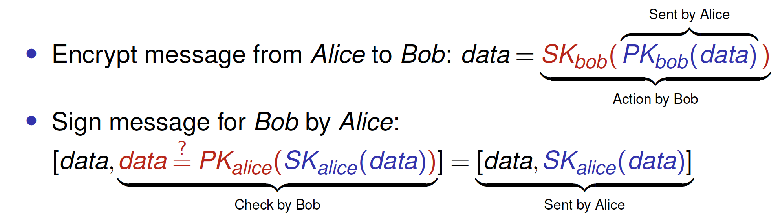
Introduction
Design goals
Security mechanisms
Symmetric cryptosystem
With encryption key E_{K} (data) and decryption key D_{K} (data):
if data = D_{K} (E_{K} (data)) then D_{K} = E_{K} . Note: encryption and descryption key are the same and should be kept secret.
Asymmetric cryptosystem
Distinguish a public key PK (data) and a private (secret) key SK (data).
Security

Slide 37
Introduction
Design goals
Security mechanisms
Secure hashing
In practice, we use secure hash functions: H(data) returns a fixed-length string.
Any change from data to data∗ will lead to a completely different string
H(data∗).
Given a hash value, it is computationally impossible to find a data with
h = H(data)
Security

Slide 38
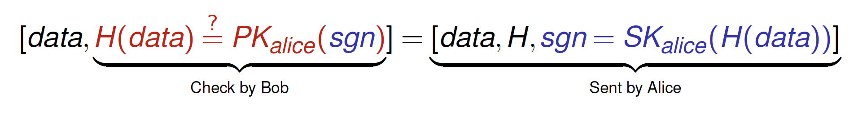
Introduction
Design goals
Security mechanisms
Secure hashing
In practice, we use secure hash functions: H(data) returns a fixed-length string.
Any change from data to data∗ will lead to a completely different string
H(data∗).
Given a hash value, it is computationally impossible to find a data with
h = H(data)
Practical digital signatures
Sign message for Bob by Alice:
Security

Slide 39
Introduction
Design goals
Scale in distributed systems
Observation
Many developers of modern distributed systems easily use the adjective “scalable” without making clear why their system actually scales.
Scalability

Slide 40
Introduction
Design goals
Scale in distributed systems
Observation
Many developers of modern distributed systems easily use the adjective “scalable” without making clear why their system actually scales.
At least three components
Number of users or processes (size scalability)
Maximum distance between nodes (geographical scalability)
Number of administrative domains (administrative scalability)
Scalability

Slide 41
Introduction
Design goals
Scale in distributed systems
Observation
Many developers of modern distributed systems easily use the adjective “scalable” without making clear why their system actually scales.
At least three components
Number of users or processes (size scalability)
Maximum distance between nodes (geographical scalability)
Number of administrative domains (administrative scalability)
Observation
Most systems account only, to a certain extent, for size scalability. Often a solution: multiple powerful servers operating independently in parallel. Today, the challenge still lies in geographical and administrative scalability.
Scalability

Slide 42
Size scalability
Introduction Design goals
Root causes for scalability problems with centralized solutions
The computational capacity, limited by the CPUs
The storage capacity, including the transfer rate between CPUs and disks
The network between the user and the centralized service
Scalability

Slide 43
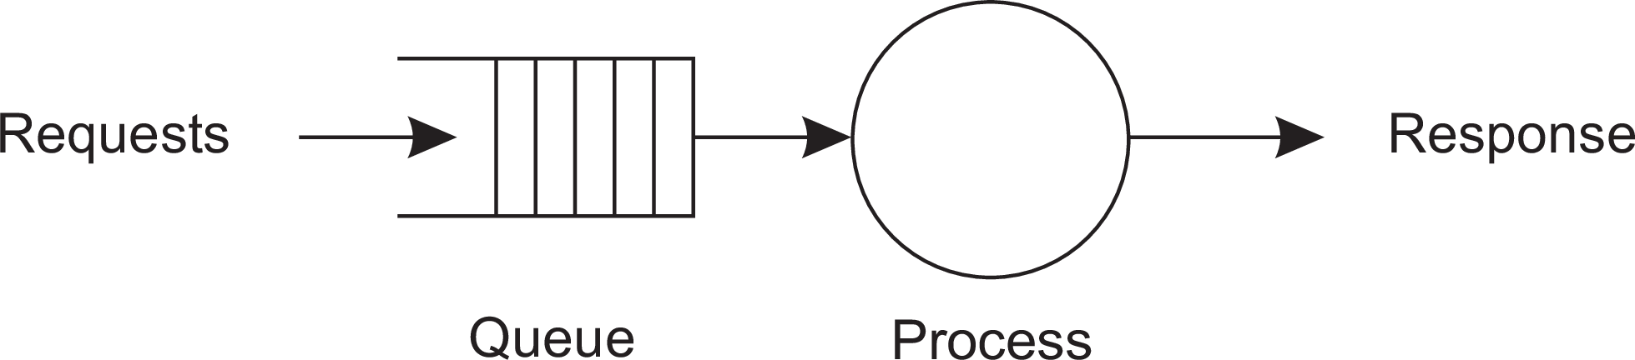
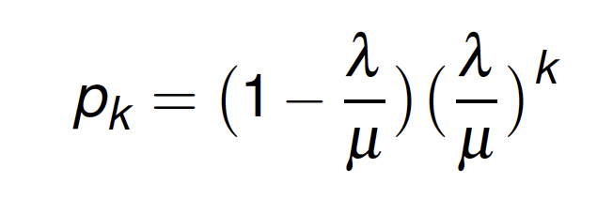
Introduction
Design goals
Formal analysis
A centralized service can be modeled as a simple queuing system
Assumptions and notations
The queue has infinite capacity ⇒ arrival rate of requests is not influenced by current queue length or what is being processed.
Arrival rate requests: λ
Processing capacity service: µ requests per second
Fraction of time having k requests in the system
Scalability

Slide 44
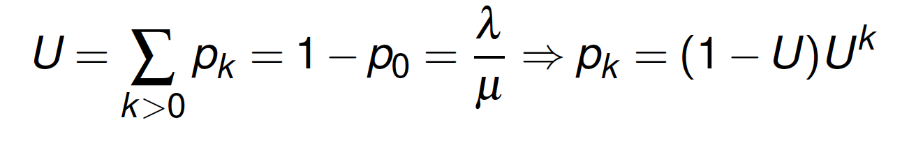
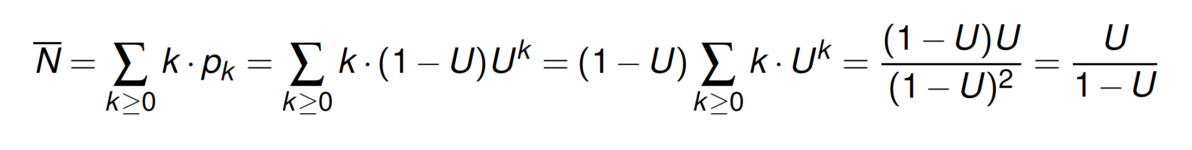
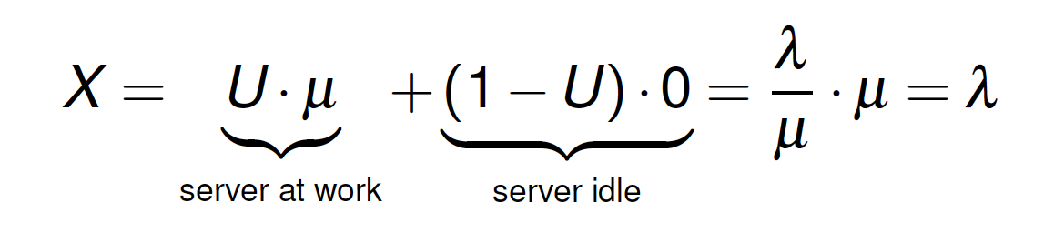
Introduction
Design goals
Formal analysis
Utilization U of a service is the fraction of time that it is busy
Average number of requests in the system
Average throughput
Scalability

Slide 45
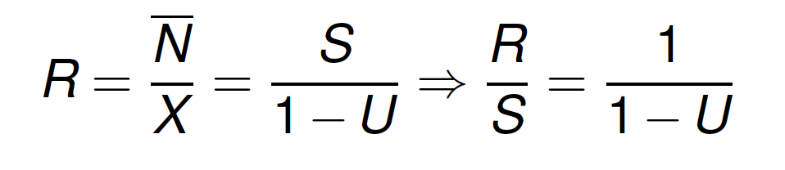
Introduction
Design goals
Formal analysis
Response time: total time take to process a request after submission
with S = ¹ being the service time.
µ
Observations
If U is small, response-to-service time is close to 1: a request is immediately processed
If U goes up to 1, the system comes to a grinding halt. Solution: decrease S.
Scalability

Slide 46
Introduction
Design goals
Problems with geographical scalability
Cannot simply go from LAN to WAN: many distributed systems assume synchronous client-server interactions: client sends request and waits for an answer. Latency may easily prohibit this scheme.
WAN links are often inherently unreliable: simply moving streaming video from LAN to WAN is bound to fail.
Lack of multipoint communication, so that a simple search broadcast cannot be deployed. Solution is to develop separate naming and directory services (having their own scalability problems).
Scalability

Slide 47
Introduction
Design goals
Problems with administrative scalability
Essence
Conflicting policies concerning usage (and thus payment), management, and security
Examples
Computational grids: share expensive resources between different domains.
Shared equipment: how to control, manage, and use a shared radio telescope constructed as large-scale shared sensor network?
Exception: several peer-to-peer networks
File-sharing systems (based, e.g., on BitTorrent)
Peer-to-peer telephony (early versions of Skype)
Peer-assisted audio streaming (Spotify)
Note: end users collaborate and not administrative entities.
Scalability

Slide 48
Introduction
Design goals
Techniques for scaling
Hide communication latencies
Make use of asynchronous communication
Have separate handler for incoming response
Problem: not every application fits this model
Scalability

Slide 49
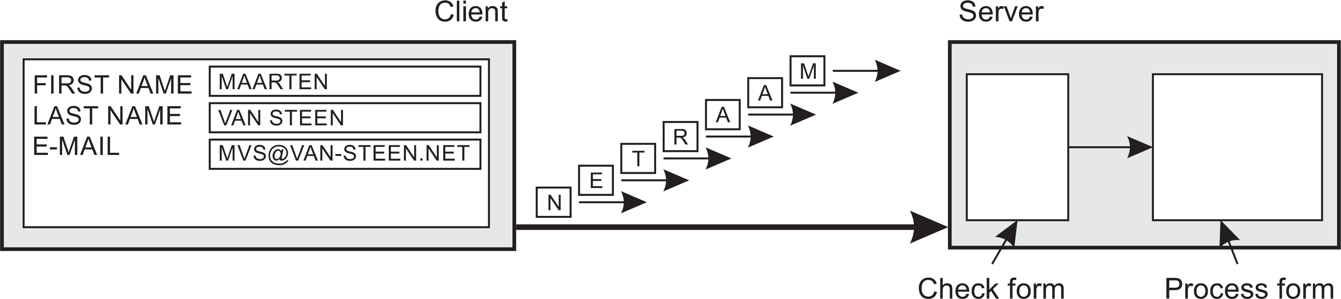
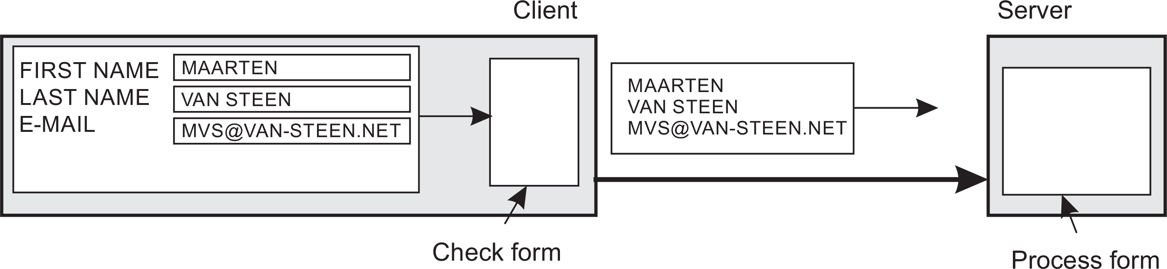
Introduction
Design goals
Techniques for scaling
Facilitate solution by moving computations to client
Scalability

Slide 50
Introduction
Design goals
Techniques for scaling
Partition data and computations across multiple machines
Move computations to clients (Java applets and scripts)
Decentralized naming services (DNS)
Decentralized information systems (WWW)
Scalability

Slide 51
Introduction
Design goals
Techniques for scaling
Replication and caching: Make copies of data available at different machines
Replicated file servers and databases
Mirrored Websites
Web caches (in browsers and proxies)
File caching (at server and client)
Scalability

Slide 52
Introduction
Design goals
Scaling: The problem with replication
Applying replication is easy, except for one thing
Scalability

Slide 53
Introduction
Design goals
Scaling: The problem with replication
Applying replication is easy, except for one thing
Having multiple copies (cached or replicated), leads to inconsistencies: modifying one copy makes that copy different from the rest.
Scalability

Slide 54
Introduction
Design goals
Scaling: The problem with replication
Applying replication is easy, except for one thing
Having multiple copies (cached or replicated), leads to inconsistencies: modifying one copy makes that copy different from the rest.
Always keeping copies consistent and in a general way requires global synchronization on each modification.
Scalability

Slide 55
Introduction
Design goals
Scaling: The problem with replication
Applying replication is easy, except for one thing
Having multiple copies (cached or replicated), leads to inconsistencies: modifying one copy makes that copy different from the rest.
Always keeping copies consistent and in a general way requires global synchronization on each modification.
Global synchronization precludes large-scale solutions.
Scalability

Slide 56
Introduction
Design goals
Scaling: The problem with replication
Applying replication is easy, except for one thing
Having multiple copies (cached or replicated), leads to inconsistencies: modifying one copy makes that copy different from the rest.
Always keeping copies consistent and in a general way requires global synchronization on each modification.
Global synchronization precludes large-scale solutions.
Observation
If we can tolerate inconsistencies, we may reduce the need for global synchronization, but tolerating inconsistencies is application dependent.
Scalability

Slide 57
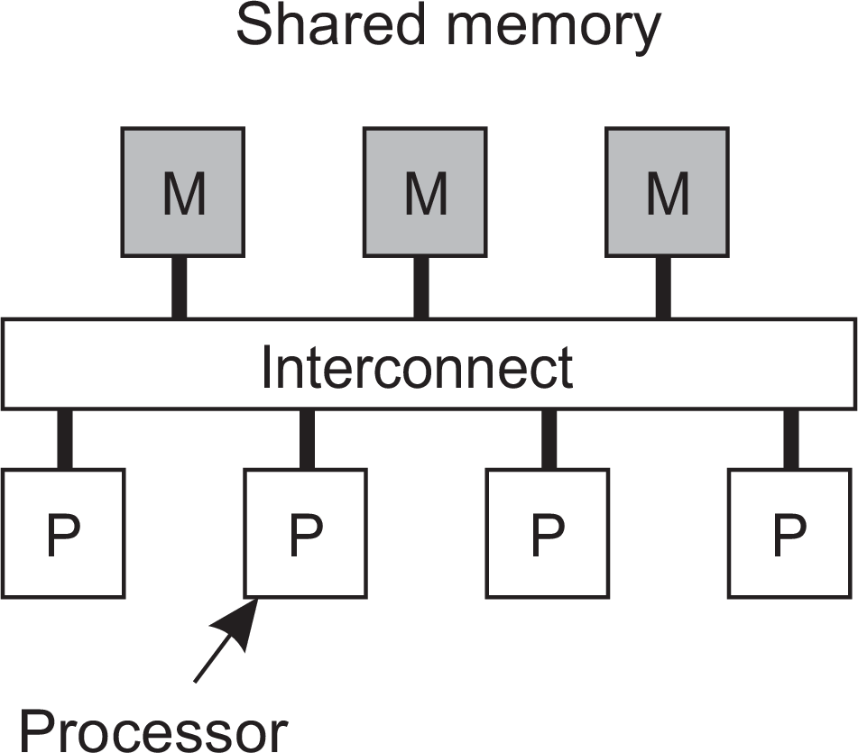
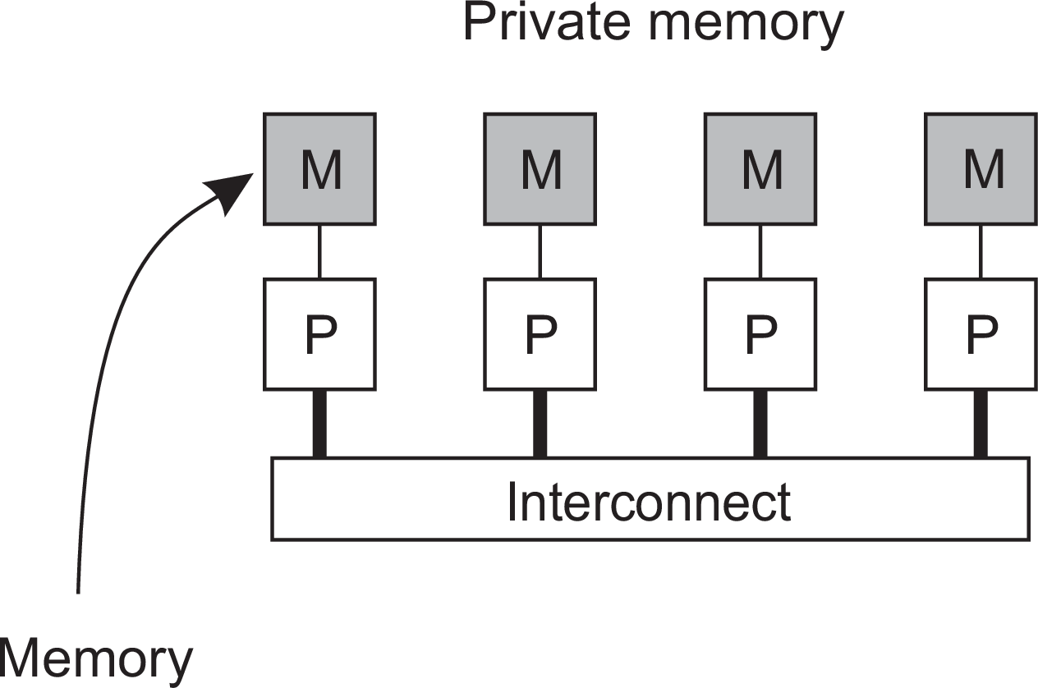
Parallel computing
Introduction A simple classification of distributed systems
Observation
High-performance distributed computing started with parallel computing
Multiprocessor and multicore versus multicomputer
High-performance distributed computing

Slide 58
Distributed shared memory systems
Introduction A simple classification of distributed systems
Observation
Multiprocessors are relatively easy to program in comparison to multicomputers, yet have problems when increasing the number of processors (or cores). Solution: Try to implement a shared-memory model on top of a multicomputer.
Example through virtual-memory techniques
Map all main-memory pages (from different processors) into one single virtual address space. If a process at processor A addresses a page P located at processor B, the OS at A traps and fetches P from B, just as it would if P had been located on local disk.
Problem
Performance of distributed shared memory could never compete with that of multiprocessors, and failed to meet the expectations of programmers. It has been widely abandoned by now.
High-performance distributed computing

Slide 59
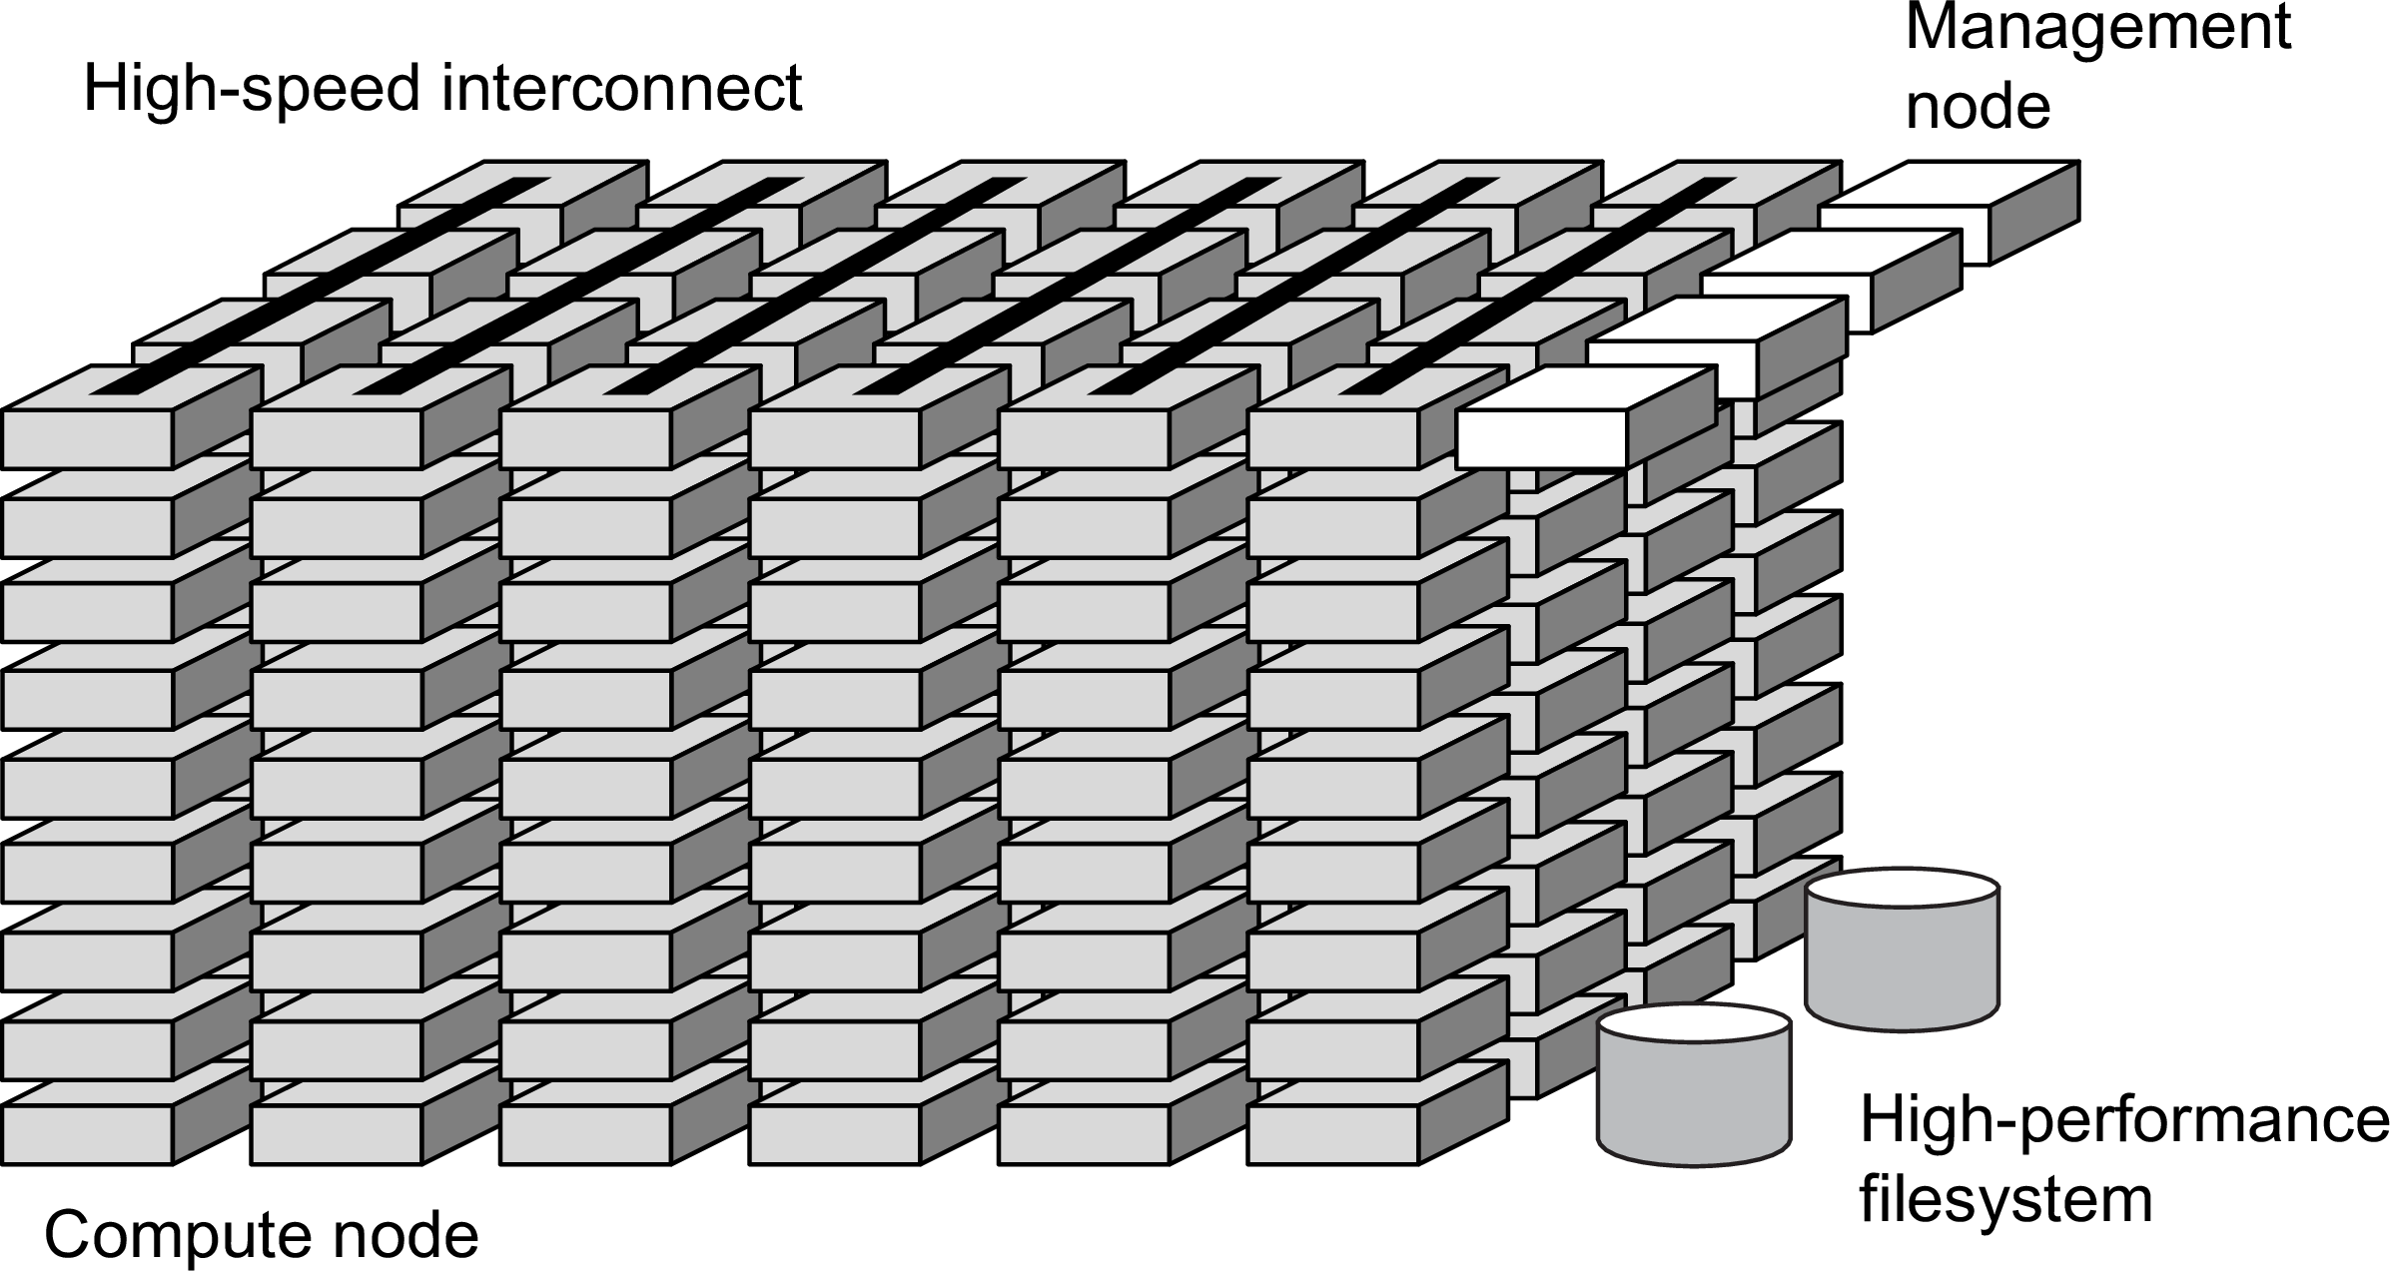
Cluster computing
Introduction A simple classification of distributed systems
Essentially a group of high-end systems connected through a LAN
Homogeneous: same OS, near-identical hardware
Single, or tightly coupled managing node(s)
High-performance distributed computing

Slide 60
Introduction
A simple classification of distributed systems
Grid computing
The next step: plenty of nodes from everywhere
Heterogeneous
Dispersed across several organizations
Can easily span a wide-area network
Note
To allow for collaborations, grids generally use virtual organizations. In essence, this is a grouping of users (or better: their IDs) that allows for authorization on resource allocation.
High-performance distributed computing

Slide 61
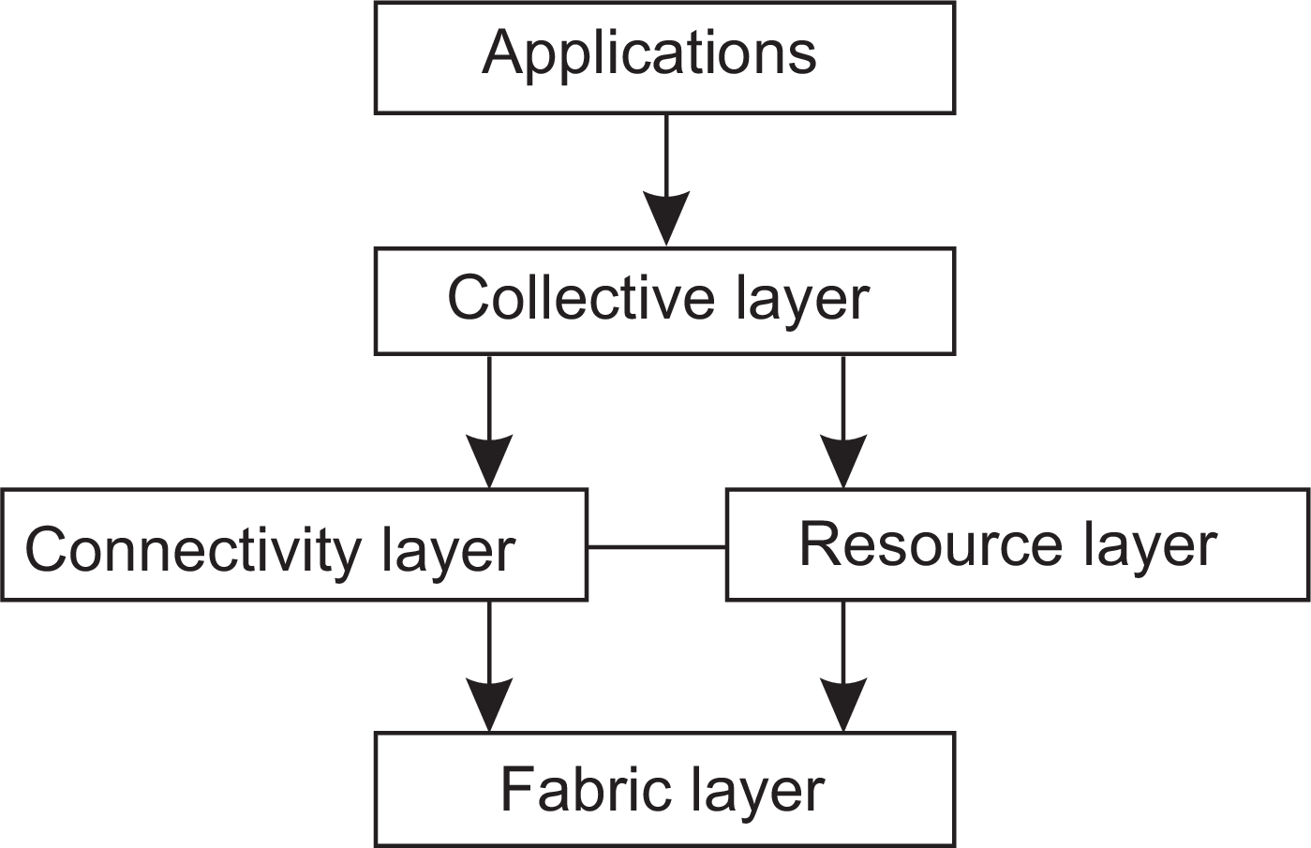
Architecture for grid computing
Introduction A simple classification of distributed systems
The layers
Fabric: Provides interfaces to local resources (for querying state and capabilities, locking, etc.)
Connectivity: Communication/transaction protocols, e.g., for moving data between resources. Also various authentication protocols.
Resource: Manages a single resource, such as creating processes or reading data.
Collective: Handles access to multiple resources: discovery, scheduling, replication.
Application: Contains actual grid applications in a single organization.
High-performance distributed computing

Slide 62
Integrating applications
Introduction A simple classification of distributed systems
Situation
Organizations confronted with many networked applications, but achieving interoperability was painful.
Basic approach
A networked application is one that runs on a server making its services available to remote clients. Simple integration: clients combine requests for (different) applications; send that off; collect responses, and present a coherent result to the user.
Next step
Allow direct application-to-application communication, leading to Enterprise Application Integration.
Distributed information systems

Slide 63
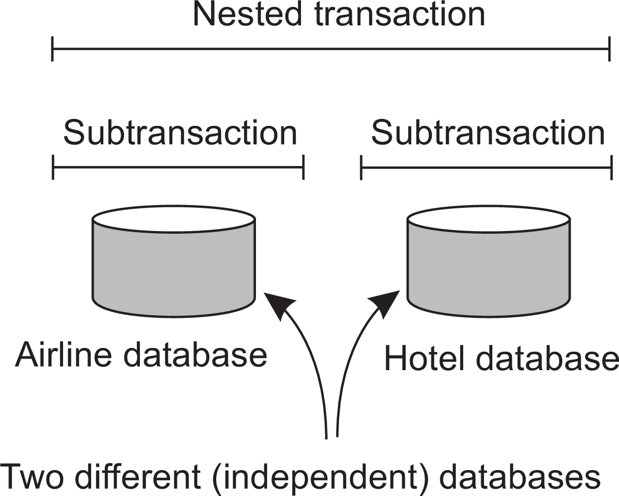
Introduction
A simple classification of distributed systems
Example EAI: (nested) transactions
Transaction
Primitive | Description
BEGIN TRANSACTION | Mark the start of a transaction
END TRANSACTION | Terminate the transaction and try to commit
ABORT TRANSACTION | Kill the transaction and restore the old values
READ | Read data from a file, a table, or otherwise
WRITE | Write data to a file, a table, or otherwise
Issue: all-or-nothing
Atomic: happens indivisibly (seemingly)
Consistent: does not violate system invariants
Isolated: not mutual interference
Durable: commit means changes are permanent
Distributed information systems

Slide 64
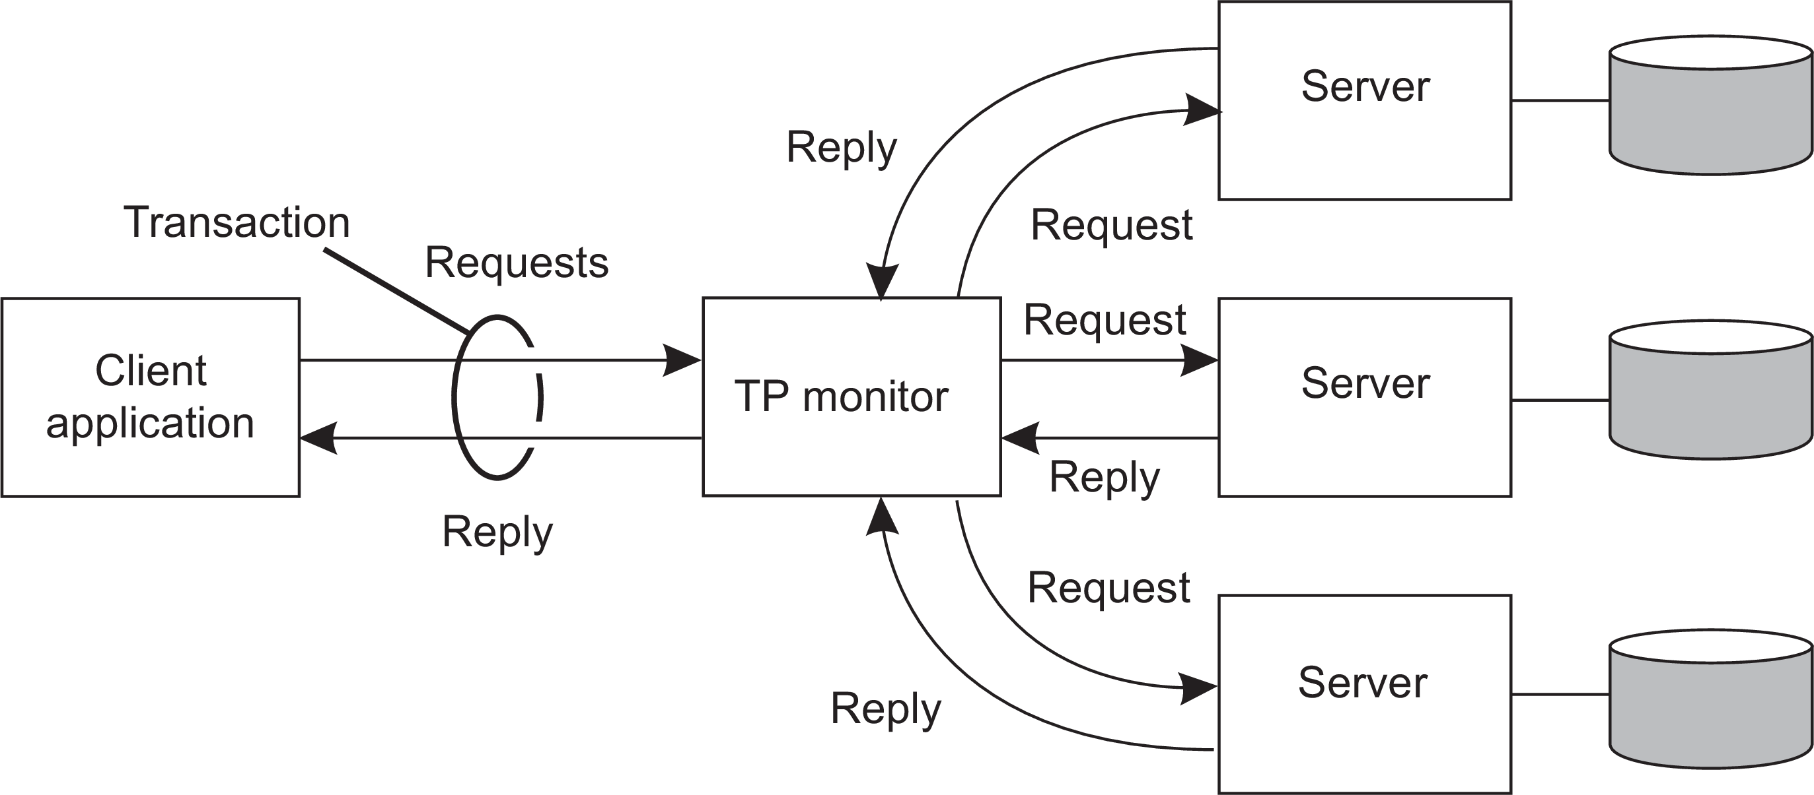
Introduction
A simple classification of distributed systems
TPM: Transaction Processing Monitor
Observation
Often, the data involved in a transaction is distributed across several servers. A TP Monitor is responsible for coordinating the execution of a transaction.
Distributed information systems

Slide 65
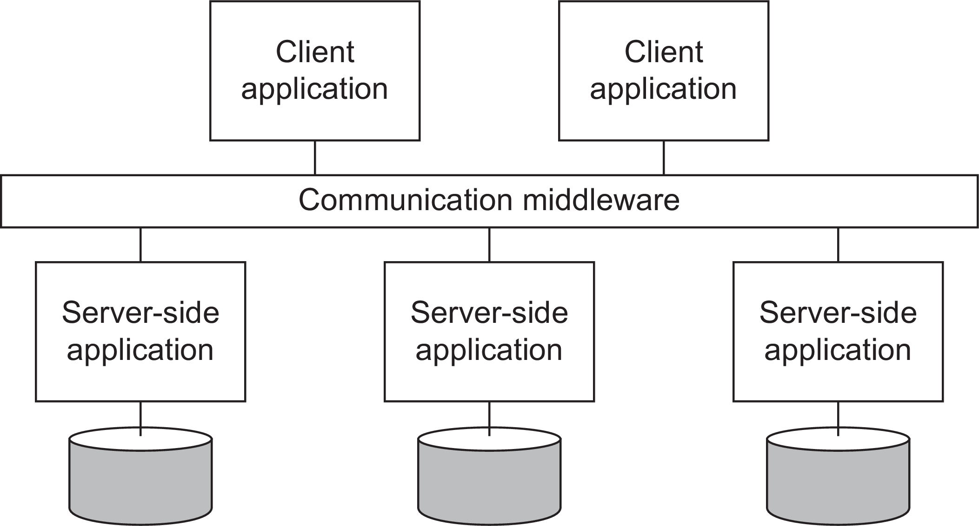
Introduction
A simple classification of distributed systems
Middleware and EAI
Middleware offers communication facilities for integration
Remote Procedure Call (RPC): Requests are sent through local procedure call, packaged as message, processed, responded through message, and result returned as return from call.
Message Oriented Middleware (MOM): Messages are sent to logical contact point (published), and forwarded to subscribed applications.
Distributed information systems

Slide 66
Introduction
A simple classification of distributed systems
How to integrate applications
File transfer: Technically simple, but not flexible:
Figure out file format and layout
Figure out file management
Update propagation, and update notifications.
Shared database: Much more flexible, but still requires common data scheme next to risk of bottleneck.
Remote procedure call: Effective when execution of a series of actions is needed.
Messaging: RPCs require caller and callee to be up and running at the same time. Messaging allows decoupling in time and space.
Distributed information systems

Slide 67
Distributed pervasive systems
Introduction A simple classification of distributed systems
Observation
Emerging next-generation of distributed systems in which nodes are small, mobile, and often embedded in a larger system, characterized by the fact that the system naturally blends into the user’s environment.
Three (overlapping) subtypes
Pervasive systems

Slide 68
Distributed pervasive systems
Introduction A simple classification of distributed systems
Observation
Emerging next-generation of distributed systems in which nodes are small, mobile, and often embedded in a larger system, characterized by the fact that the system naturally blends into the user’s environment.
Three (overlapping) subtypes
Ubiquitous computing systems: pervasive and continuously present, i.e., there is a continuous interaction between system and user.
Pervasive systems

Slide 69
Distributed pervasive systems
Introduction A simple classification of distributed systems
Observation
Emerging next-generation of distributed systems in which nodes are small, mobile, and often embedded in a larger system, characterized by the fact that the system naturally blends into the user’s environment.
Three (overlapping) subtypes
Ubiquitous computing systems: pervasive and continuously present, i.e., there is a continuous interaction between system and user.
Mobile computing systems: pervasive, but emphasis is on the fact that devices are inherently mobile.
Pervasive systems

Slide 70
Distributed pervasive systems
Introduction A simple classification of distributed systems
Observation
Emerging next-generation of distributed systems in which nodes are small, mobile, and often embedded in a larger system, characterized by the fact that the system naturally blends into the user’s environment.
Three (overlapping) subtypes
Ubiquitous computing systems: pervasive and continuously present, i.e., there is a continuous interaction between system and user.
Mobile computing systems: pervasive, but emphasis is on the fact that devices are inherently mobile.
Sensor (and actuator) networks: pervasive, with emphasis on the actual (collaborative) sensing and actuation of the environment.
Pervasive systems

Slide 71
Ubiquitous systems
Introduction A simple classification of distributed systems
Core elements
(Distribution) Devices are networked, distributed, and accessible transparently
(Interaction) Interaction between users and devices is highly unobtrusive
(Context awareness) The system is aware of a user’s context to optimize interaction
(Autonomy) Devices operate autonomously without human intervention, and are thus highly self-managed
(Intelligence) The system as a whole can handle a wide range of dynamic actions and interactions
Pervasive systems

Slide 72
Mobile computing
Introduction A simple classification of distributed systems
Distinctive features
A myriad of different mobile devices (smartphones, tablets, GPS devices, remote controls, active badges).
Mobile implies that a device’s location is expected to change over time ⇒
change of local services, reachability, etc. Keyword: discovery.
Maintaining stable communication can introduce serious problems.
For a long time, research has focused on directly sharing resources between mobile devices. It never became popular and is by now considered to be a fruitless path for research.
Pervasive systems

Slide 73
Mobile computing
Introduction A simple classification of distributed systems
Distinctive features
A myriad of different mobile devices (smartphones, tablets, GPS devices, remote controls, active badges).
Mobile implies that a device’s location is expected to change over time ⇒
change of local services, reachability, etc. Keyword: discovery.
Maintaining stable communication can introduce serious problems.
For a long time, research has focused on directly sharing resources between mobile devices. It never became popular and is by now considered to be a fruitless path for research.
Bottomline
Mobile devices set up connections to stationary servers, essentially bringing mobile computing in the position of clients of cloud-based services.
Pervasive systems

Slide 74
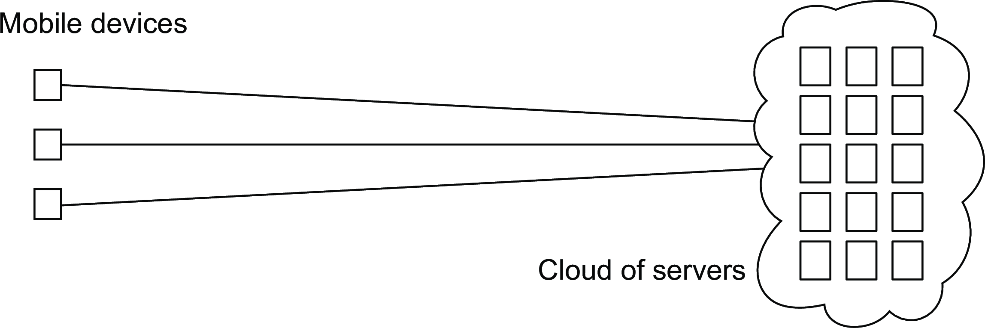
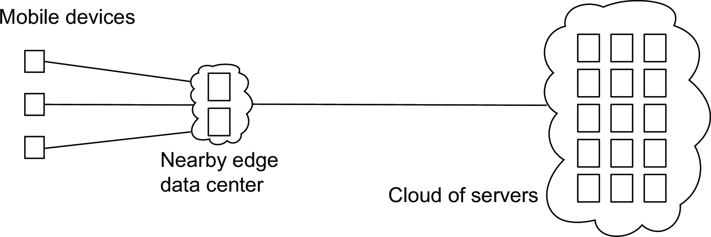
Introduction
A simple classification of distributed systems
Mobile computing
Mobile cloud computing
Mobile edge computing
Pervasive systems

Slide 75
Sensor networks
Introduction A simple classification of distributed systems
Characteristics
The nodes to which sensors are attached are:
Many (10s-1000s)
Simple (small memory/compute/communication capacity)
Often battery-powered (or even battery-less)
Pervasive systems

Slide 76
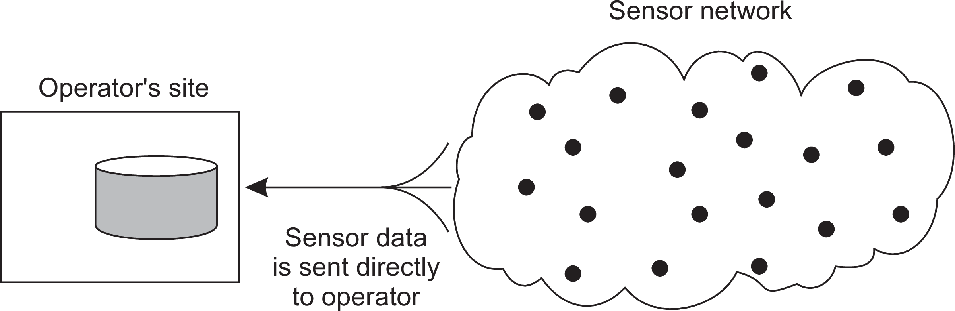
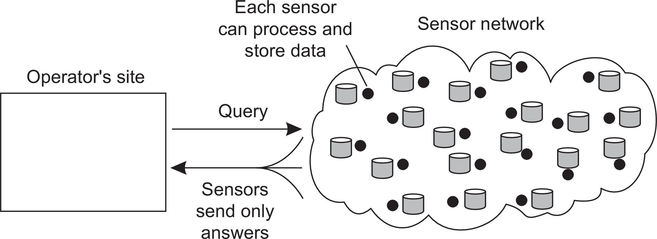
Introduction
A simple classification of distributed systems
Sensor networks as distributed databases
Two extremes
Pervasive systems

Slide 77
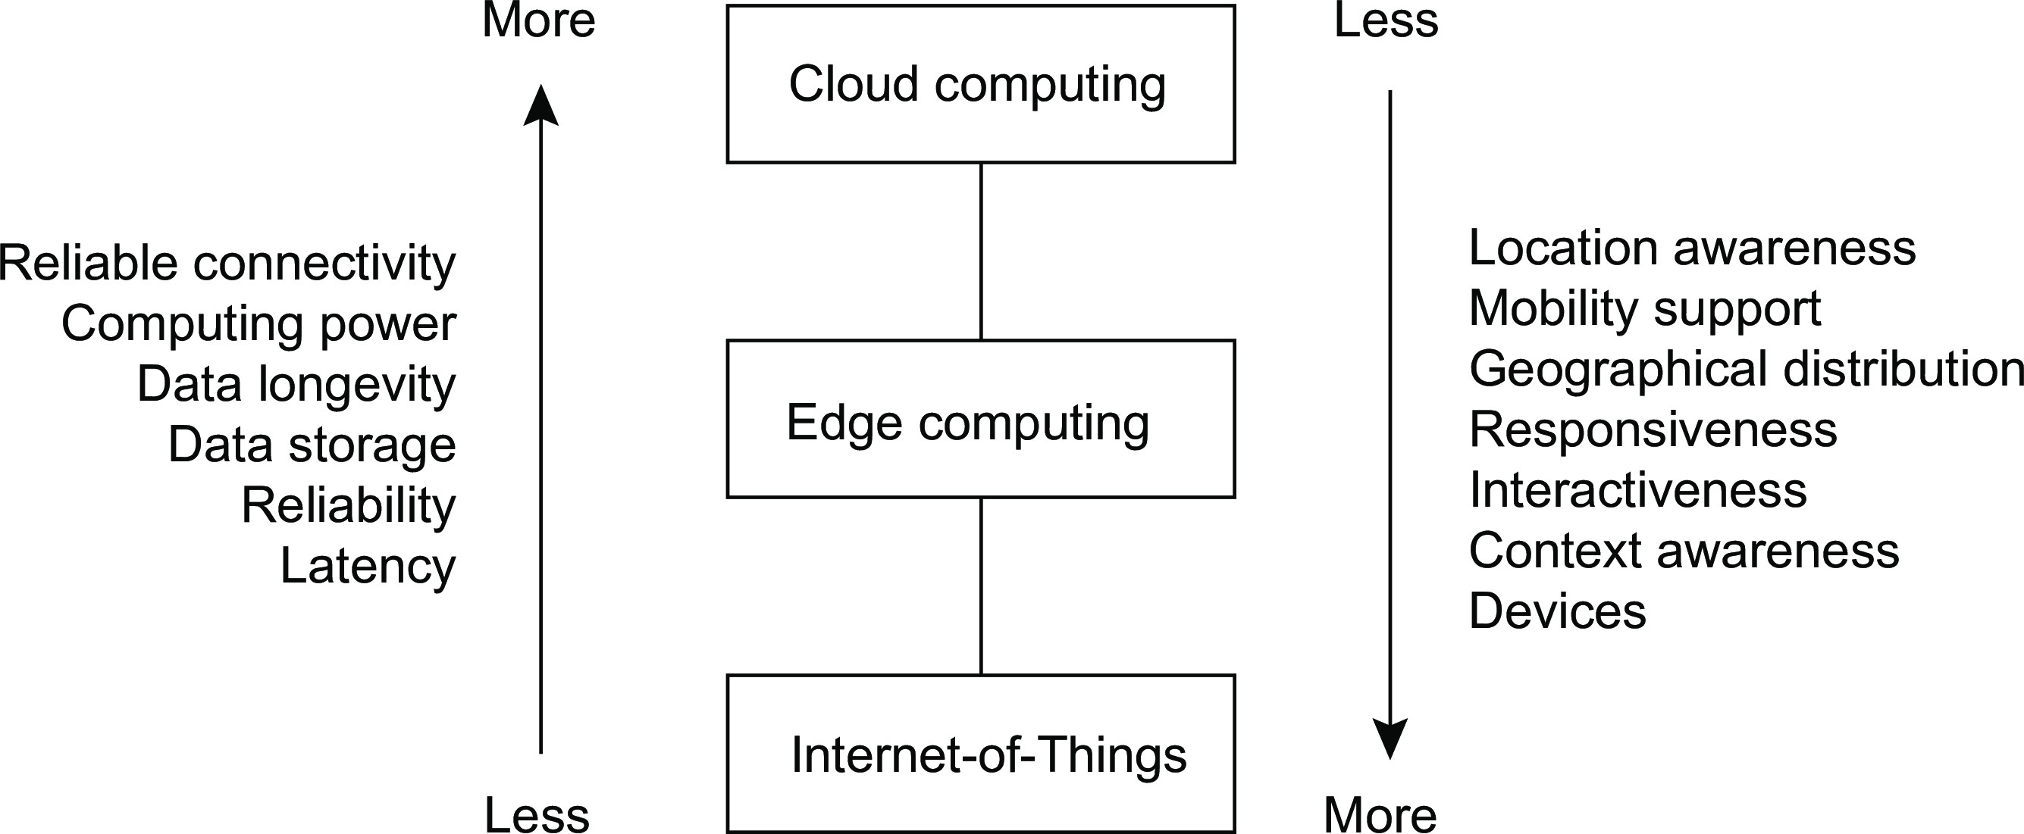
Introduction
A simple classification of distributed systems
The cloud-edge continuum
Pervasive systems

Slide 78
Introduction
Pitfalls
Developing distributed systems: Pitfalls
Observation
Many distributed systems are needlessly complex, caused by mistakes that required patching later on. Many false assumptions are often made.

Slide 79
Introduction
Pitfalls
Developing distributed systems: Pitfalls
Observation
Many distributed systems are needlessly complex, caused by mistakes that required patching later on. Many false assumptions are often made.
False (and often hidden) assumptions

Slide 80
Introduction
Pitfalls
Developing distributed systems: Pitfalls
Observation
Many distributed systems are needlessly complex, caused by mistakes that required patching later on. Many false assumptions are often made.
False (and often hidden) assumptions
The network is reliable

Slide 81
Introduction
Pitfalls
Developing distributed systems: Pitfalls
Observation
Many distributed systems are needlessly complex, caused by mistakes that required patching later on. Many false assumptions are often made.
False (and often hidden) assumptions
The network is reliable
The network is secure

Slide 82
Introduction
Pitfalls
Developing distributed systems: Pitfalls
Observation
Many distributed systems are needlessly complex, caused by mistakes that required patching later on. Many false assumptions are often made.
False (and often hidden) assumptions
The network is reliable
The network is secure
The network is homogeneous

Slide 83
Introduction
Pitfalls
Developing distributed systems: Pitfalls
Observation
Many distributed systems are needlessly complex, caused by mistakes that required patching later on. Many false assumptions are often made.
False (and often hidden) assumptions
The network is reliable
The network is secure
The network is homogeneous
The topology does not change

Slide 84
Introduction
Pitfalls
Developing distributed systems: Pitfalls
Observation
Many distributed systems are needlessly complex, caused by mistakes that required patching later on. Many false assumptions are often made.
False (and often hidden) assumptions
The network is reliable
The network is secure
The network is homogeneous
The topology does not change
Latency is zero

Slide 85
Introduction
Pitfalls
Developing distributed systems: Pitfalls
Observation
Many distributed systems are needlessly complex, caused by mistakes that required patching later on. Many false assumptions are often made.
False (and often hidden) assumptions
The network is reliable
The network is secure
The network is homogeneous
The topology does not change
Latency is zero
Bandwidth is infinite

Slide 86
Introduction
Pitfalls
Developing distributed systems: Pitfalls
Observation
Many distributed systems are needlessly complex, caused by mistakes that required patching later on. Many false assumptions are often made.
False (and often hidden) assumptions
The network is reliable
The network is secure
The network is homogeneous
The topology does not change
Latency is zero
Bandwidth is infinite
Transport cost is zero

Slide 87
Introduction
Pitfalls
Developing distributed systems: Pitfalls
Observation
Many distributed systems are needlessly complex, caused by mistakes that required patching later on. Many false assumptions are often made.
False (and often hidden) assumptions
The network is reliable
The network is secure
The network is homogeneous
The topology does not change
Latency is zero
Bandwidth is infinite
Transport cost is zero
There is one administrator

